Slide 1

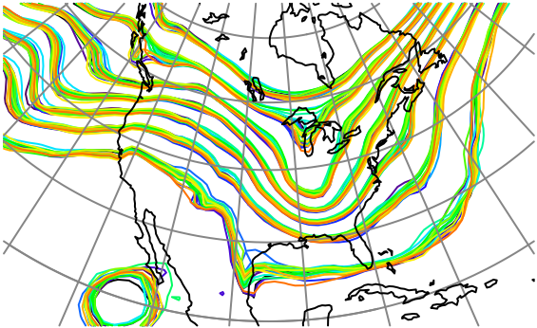

Exploiting Nonlinear Relations between Observations and State Variables in Ensemble Filters
Jeff Anderson, NCAR Data Assimilation Research Section

Slide 2
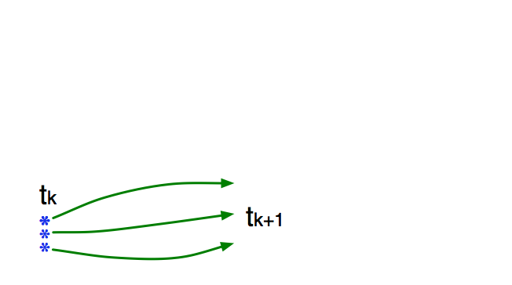
Schematic of a Sequential Ensemble Filter
Use model to advance ensemble (3 members here) to time at which next observation becomes available.
Ensemble state estimate after using previous observation (analysis)
Ensemble state at time of next observation (prior)

Slide 3
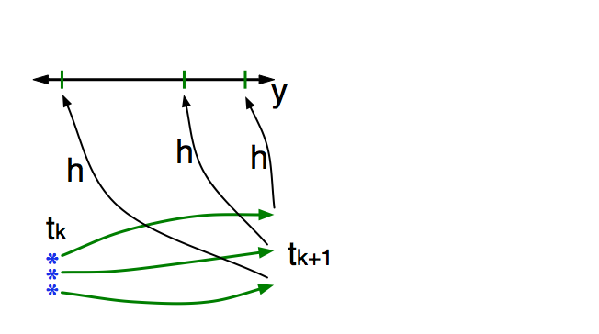
Schematic of a Sequential Ensemble Filter
Get prior ensemble sample of observation, y = h(x), by applying forward operator h to each ensemble member.
Theory: observations from instruments with uncorrelated errors can be done sequentially.
Can think about single observation without (too much) loss of generality.

Slide 4
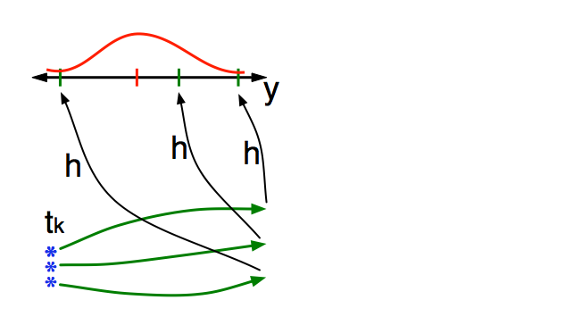
Schematic of a Sequential Ensemble Filter
Get observed value and observational error distribution from observing system.

Slide 5
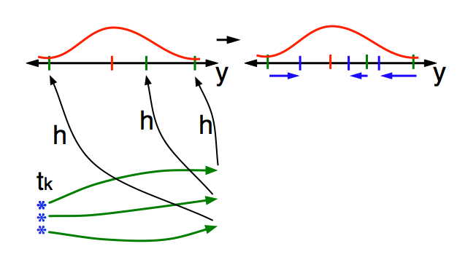
Schematic of a Sequential Ensemble Filter
Find the increments for the prior observation ensemble (this is a scalar problem for uncorrelated observation errors).
Ensemble Kalman filters assume Gaussianity for this problem.
Can compute increments without Gaussian assumptions. (Old news).

Slide 6
Schematic of a Sequential Ensemble Filter
Find the increments for the prior observation ensemble (this is a scalar problem for uncorrelated observation errors).
Students, faculty: Lots of cool problems still to be explored for non-Gaussian likelihoods. Contact me if interested.

Slide 7
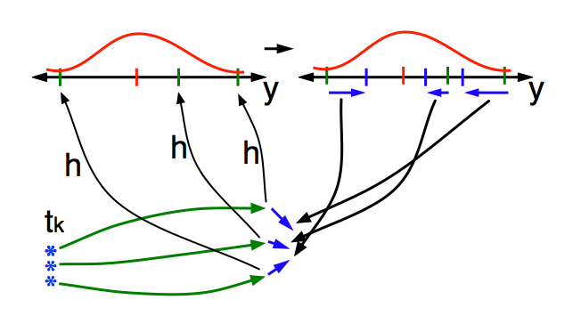
Schematic of a Sequential Ensemble Filter
Use ensemble samples of y and each state variable to linearly regress observation increments onto state variable increments.
Theory: impact of observation increments on each state variable can be handled independently!

Slide 8
Schematic of a Sequential Ensemble Filter
Use ensemble samples of y and each state variable to linearly regress observation increments onto state variable increments.
Can solve this bivariate problem in other ways. Topic of this talk.

Slide 9
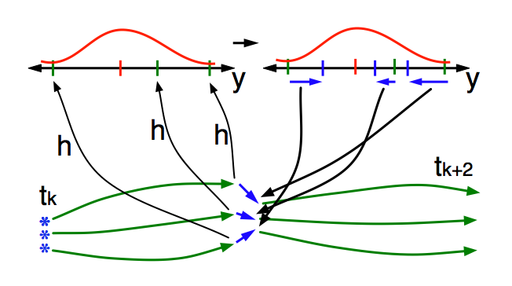
Schematic of a Sequential Ensemble Filter
When all ensemble members for each state variable are updated, there is a new analysis. Integrate to time of next observation …

Slide 10
Focus on the Regression Step
Standard ensemble filters just use bivariate sample linear regression to compute state increments.
Δx_{i,n}=bΔy_{n,}
n=1,…N.
N is ensemble size.
b is regression
coefficient.

Slide 11
Focus on the Regression Step
Will examine two additional ways to increment state given observation increments. Both still bivariate.

Slide 12
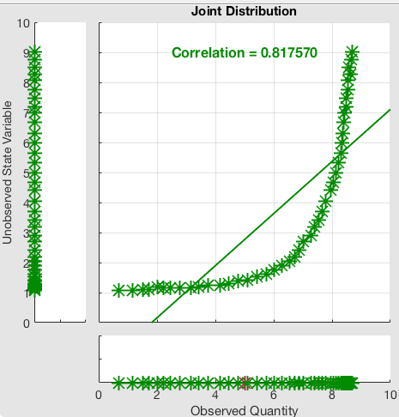
Nonlinear Regression Example
Try to exploit nonlinear prior relation between a state variable and an observation.
Example: Observation y~log(x).
Also relevant for variables that are log transformed for boundedness (like concentrations).

Slide 13
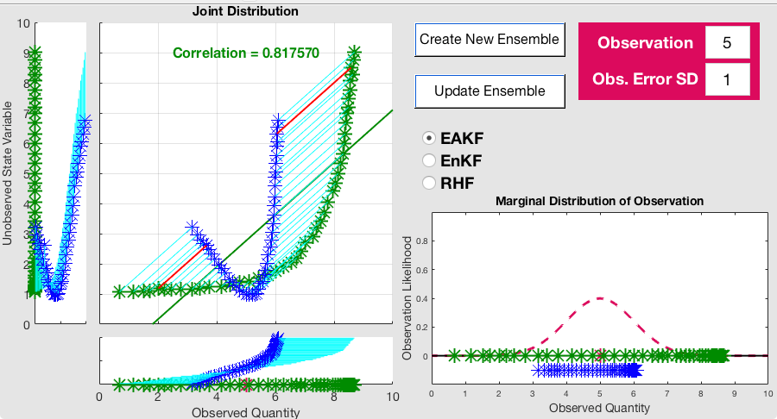
Standard Ensemble Adjustment Filter (EAKF)
Try to exploit nonlinear prior relation between a state variable and an observation.
Example: Observation y~log(x).
Also relevant for variables that are log transformed for boundedness (like concentrations).

Slide 14
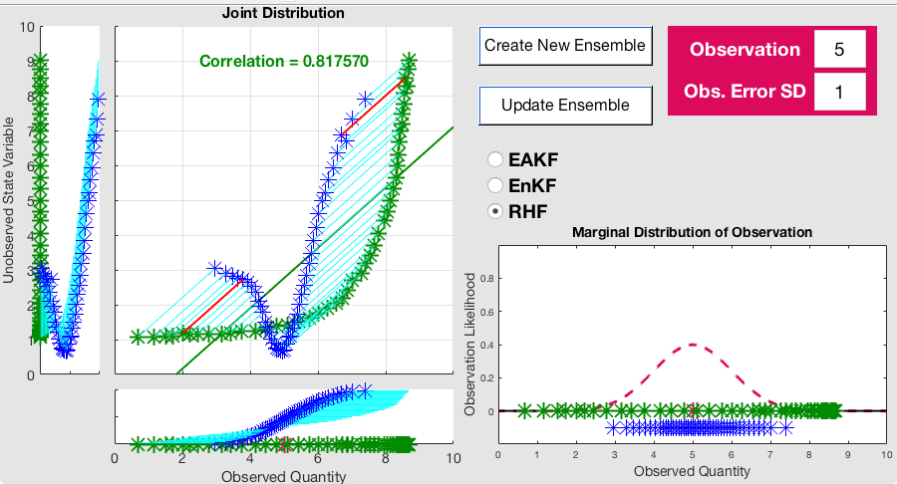
Standard Rank Histogram Filter (RHF)
Try to exploit nonlinear prior relation between a state variable and an observation.
Example: Observation y~log(x).
Also relevant for variables that are log transformed for boundedness (like concentrations).

Slide 15
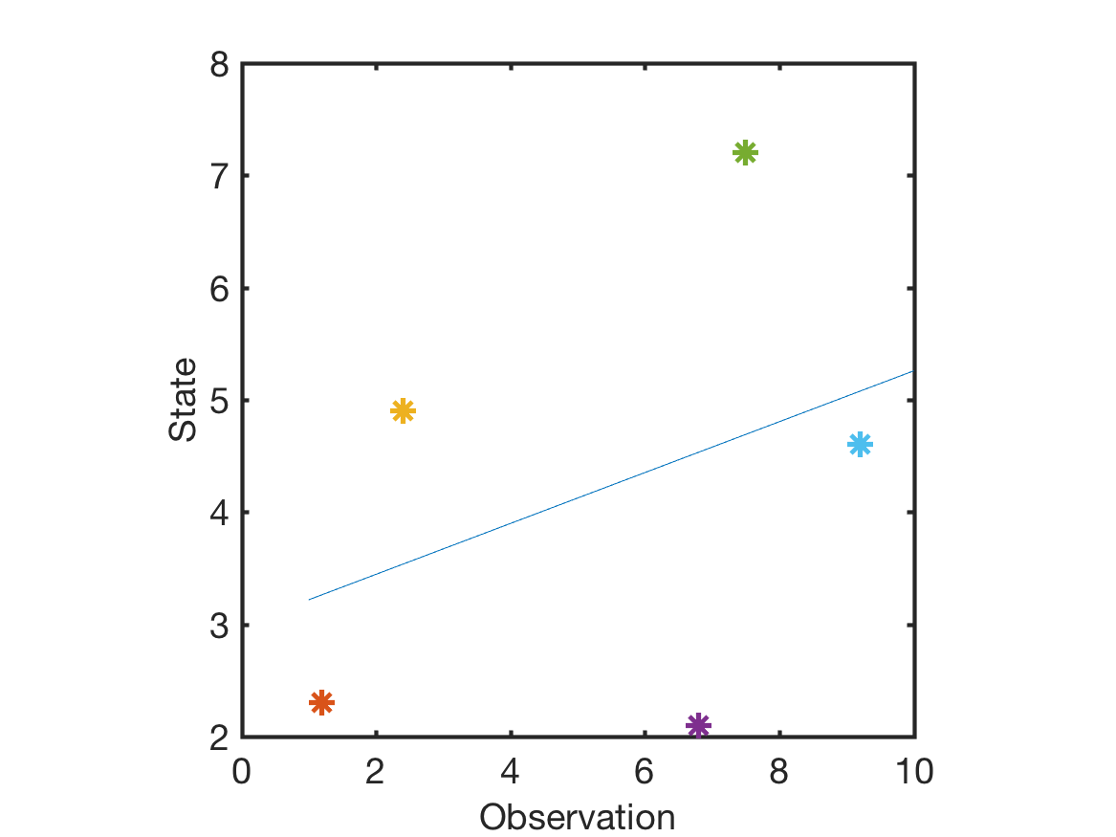
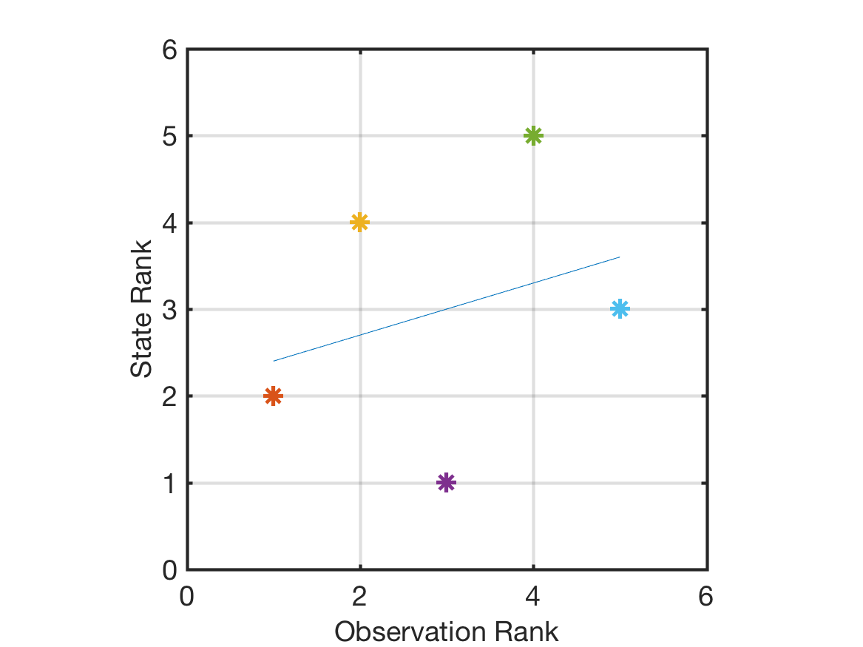
Rank Regression
Convert bivariate ensemble to bivariate rank ensemble.
Do least squares on bivariate rank ensemble.
Standard regression
Rank regression
Noisy
Relation.

Slide 16
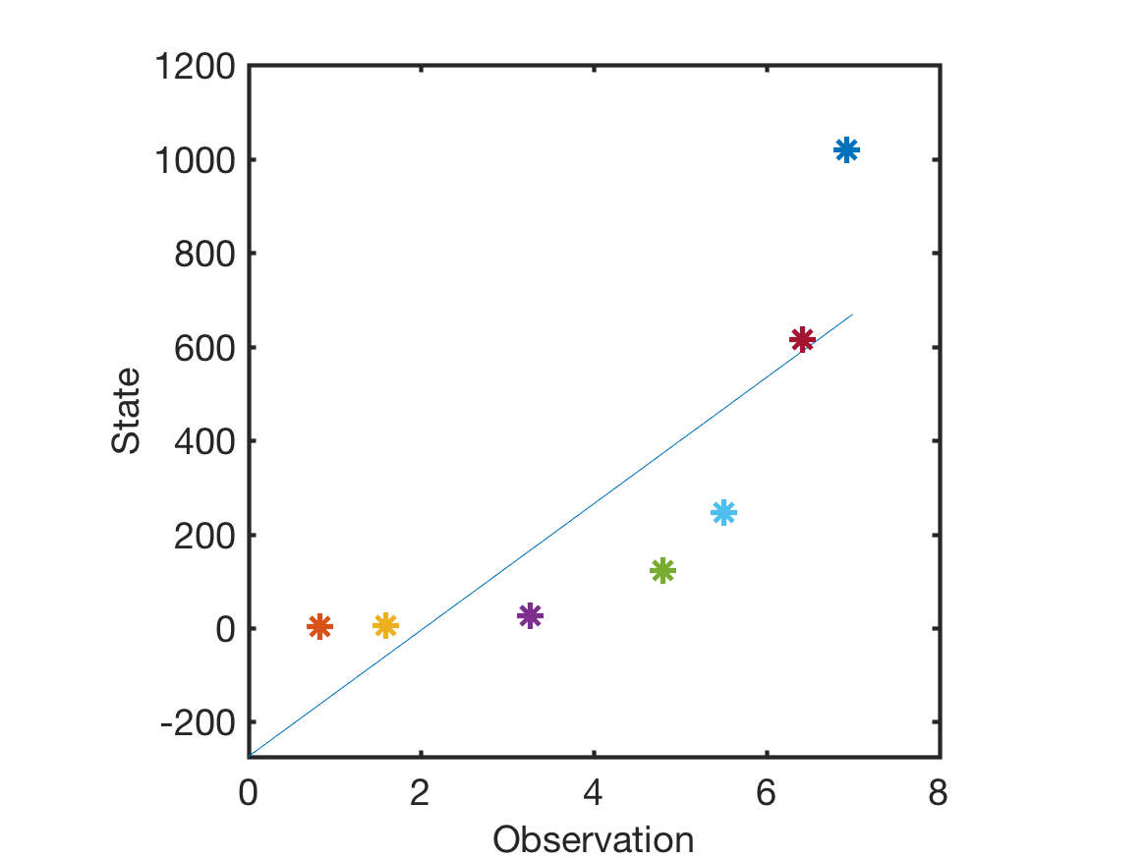
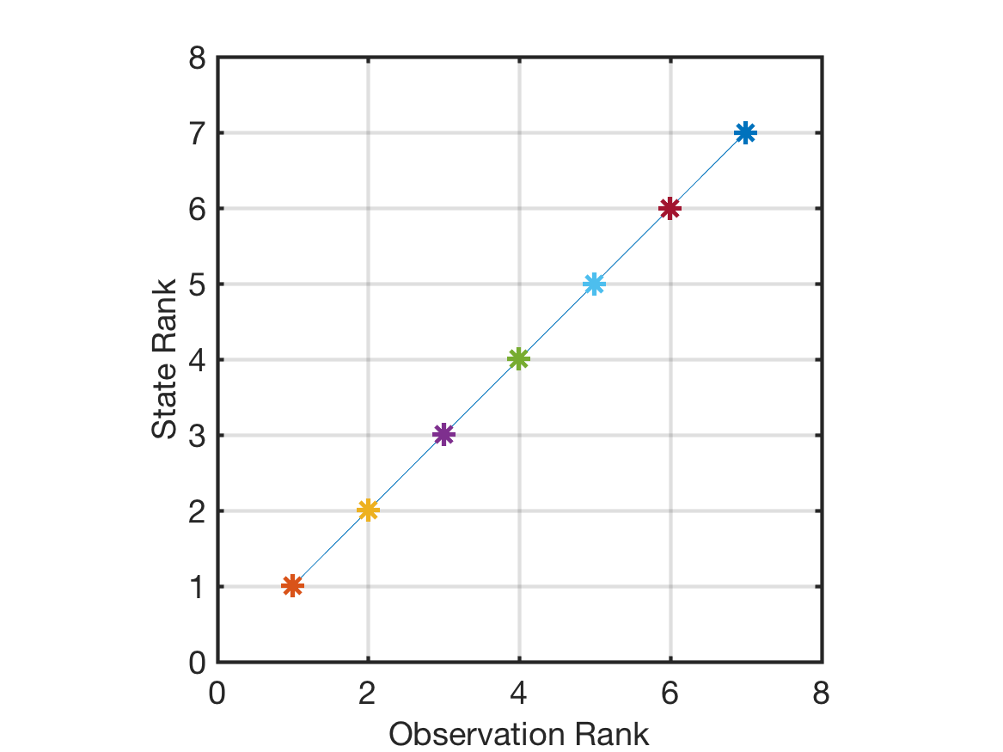
Rank Regression
Convert bivariate ensemble to bivariate rank ensemble.
Do least squares on bivariate rank ensemble.
Standard regression
Rank regression
Monotonic relation.

Slide 17
Rank Regression
Convert bivariate ensemble to bivariate rank ensemble.
Do least squares on bivariate rank ensemble.
Convert observation posteriors to rank.
Extrapolate by assuming Gaussian tails on prior.
Same as Rank Histogram filter.
Regress rank increments onto state ranks.

Slide 18
Rank Regression
Convert bivariate ensemble to bivariate rank ensemble.
Do least squares on bivariate rank ensemble.
Convert observation posteriors to rank.
Extrapolate by assuming Gaussian tails on prior.
Same as Rank Histogram filter.
Regress rank increments onto state ranks.
Convert posterior state ranks to state values.
If posterior rank is outside ‘legal’ values, use weighted average of extrapolation and standard regression.

Slide 19
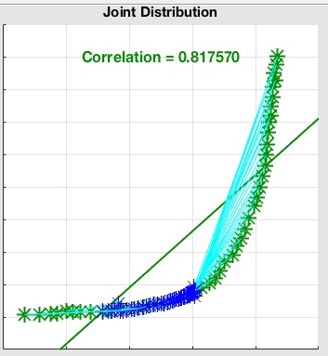
Nonlinear Regression Example
Rank regression with EAKF for observation marginal.
Follows monotonic ensemble prior ‘exactly’.

Slide 20
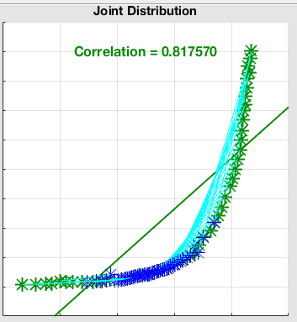
Nonlinear Regression Example
Rank regression with RHF for observation marginal.
Follows monotonic ensemble prior ‘exactly’.

Slide 21
Focus on the Regression Step
Second approach, use different ‘regression’ for each ensemble member to compute increments for x_{i}
Δx_{i,n}=b_{n}Δy_{n,}
n=1,…N.
N is ensemble size.
b_{n} is ‘local’ regression
coefficient.

Slide 22
Local Linear Regression
Relation between observation and state is nonlinear.
Try using ’local’ subset of ensemble to compute regression.
What kind of subset?
Cluster that contains ensemble member being updated.
Lots of ways to define clusters.
Here, use naïve closest neighbors in (x,y) space.
Vary number of nearest neighbors in subset.

Slide 23
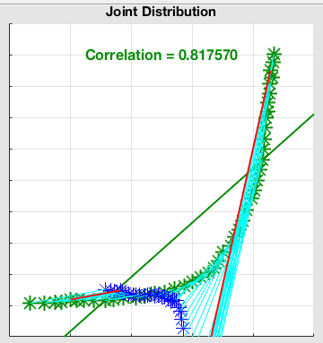
Local Linear Regression
Local ensemble subset is nearest ½ . Regression approximates local slope of the relation.

Slide 24
Local Linear Regression
Local ensemble subset is nearest ½ . Regression approximates local slope of the relation.
Highlighted red increment uses least squares fit to ensemble members in region.

Slide 25
Local Linear Regression
Slope more accurate locally, but a disaster globally.
Highlighted red increment uses least squares fit to ensemble members in region.

Slide 26
Local Linear Regression
Note similarity to Houtekamer’s method, except local ensemble members are used, rather than non-local.
Highlighted red increment uses least squares fit to ensemble members in region.

Slide 27
Local Linear Regression with Incremental Update
Local slope is just that, local.
Following it for a long way is a bad idea.
Will use a Bayesian consistent incremental update.
Observation with error variance s.
Assimilate k observations with this value.
Each of these has error variance s/k.

Slide 28

Local Linear Regression with Incremental Update
This is an RHF update with 4 increments. Individual increments highlighted for two ensemble members.
For an EAKF, posterior would be identical to machine precision.
Nearly identical for RHF.

Slide 29
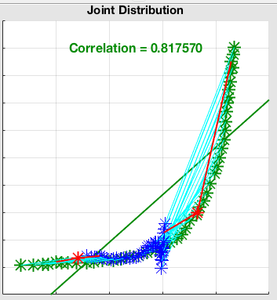
Local Linear Regression with Incremental Update
2 increments with subsets ½ ensemble.
Posterior for state qualitatively improving.

Slide 30
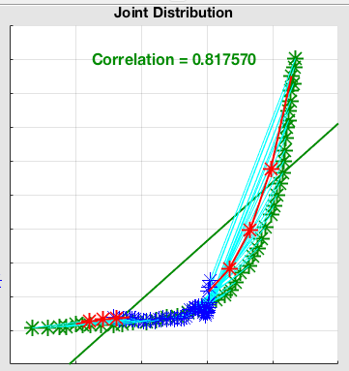
Local Linear Regression with Incremental Update
4 increments with subsets ½ ensemble.
Posterior for state qualitatively improving.

Slide 31
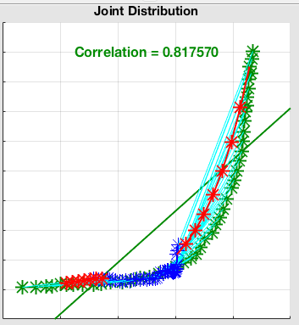
Local Linear Regression with Incremental Update
8 increments with subsets ½ ensemble.
Posterior for state qualitatively improving.

Slide 32

Local Linear Regression with Incremental Update
8 increments with subset 1/4 ensemble.
Posterior for state degraded.
Increment is moving outside of local linear validity.

Slide 33

Local Linear Regression with Incremental Update
16 increments with subset 1/4 ensemble.
Posterior for state improved.

Slide 34
Local Linear Regression with Incremental Update
If relation between observation and state is locally a continuous, smooth (first two derivatives continuous) function:
Then, in the limit of a large ensemble, fixed local subset size, and large number of increments:
The local linear regression with incremental update converges to the correct posterior distribution.

Slide 35
Local Linear Regression with Incremental Update
If relation between observation and state is locally a continuous, smooth (first two derivatives continuous) function:
Then, in the limit of a large ensemble, fixed local subset size, and large number of increments:
The local linear regression with incremental update converges to the correct posterior distribution.
This could be very expensive,
No guarantees about what goes on in the presence of noise.

Slide 36
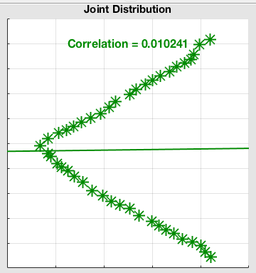
Multi-valued, not smooth example.
Similar in form to a wind speed observation with state velocity component.

Slide 37
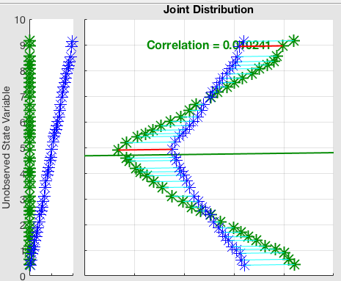
Multi-valued, not smooth example.
Standard regression does not capture bimodality of state posterior.

Slide 38

Multi-valued, not smooth example.
Rank regression nearly identical in this case.

Slide 39
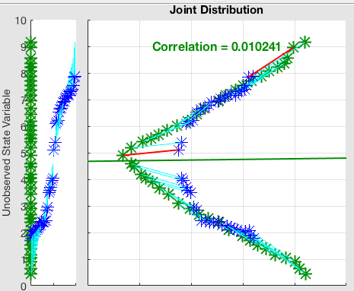
Multi-valued, not smooth example.
Local regression with ½ of the ensemble does much better.
Captures bimodal posterior.
Note problems where relation is not smooth.

Slide 40

Multi-valued, not smooth example.
Local regression with1/4 of the ensemble does even better.
No need for incremental updates here.

Slide 41
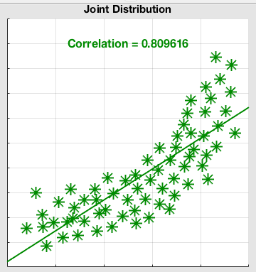
Regression with Noisy Priors
Most geophysical applications have noisy bivariate priors.
Usually hard to detect nonlinearity (even this example is still pretty extreme).

Slide 42
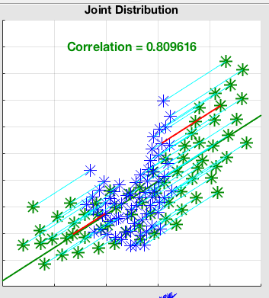
Regression with Noisy Priors
Standard regression EAKF places many posterior members outside of the prior bivariate distribution.

Slide 43

Regression with Noisy Priors
Rank regression does a significantly better job.

Slide 44
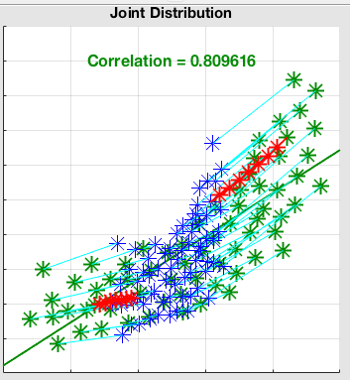
Regression with Noisy Priors
Local incremental regression. This result is for local ensemble with nearest ½ of ensemble and 8 increments.
Need bigger local ensembles to reduce sampling errors.

Slide 45
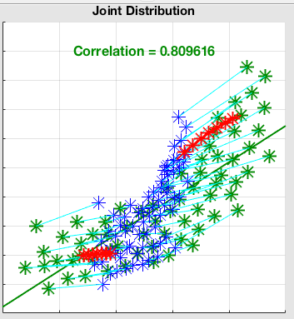
Regression with Noisy Priors
Local incremental regression. This result is for local ensemble with nearest 1/4 of ensemble and 8 increments.
The small ensemble subsets lead to large sampling error. Probably worse than standard RHF.

Slide 46
Computational Cost
Computational cost for the state variable update:
Base regression: O(m²n)
Rank regression: O(m²nlogn)
Local regression: O(m²n²logn)
m: sum of state size plus number of observations,
n: ensemble size.
Latter two can be made less on average with some work.
Good for GPUs (more computation per byte).

Slide 47
Results: Lorenz96
Standard model configuration, perfect model, three cases.
Identity observations, error variance 1, every 12 hours,
Identity observations, error variance 16, every hour,
40 random observing locations, observation is log(state), error variance 1024, every 12 hours.
Fixed multiplicative inflation, fixed Gaspari-Cohn localization.
Search through 100 pairs of inflation/localization for each case.
Results for best case.

Slide 48
Results: Local Incremental Updates
Checked subsets of 1/2, 1/4,1/8 of state variables.
Number of increments 1, 2, 4, 8.
Always did at least as well as other methods.
But, very expensive…

Slide 49
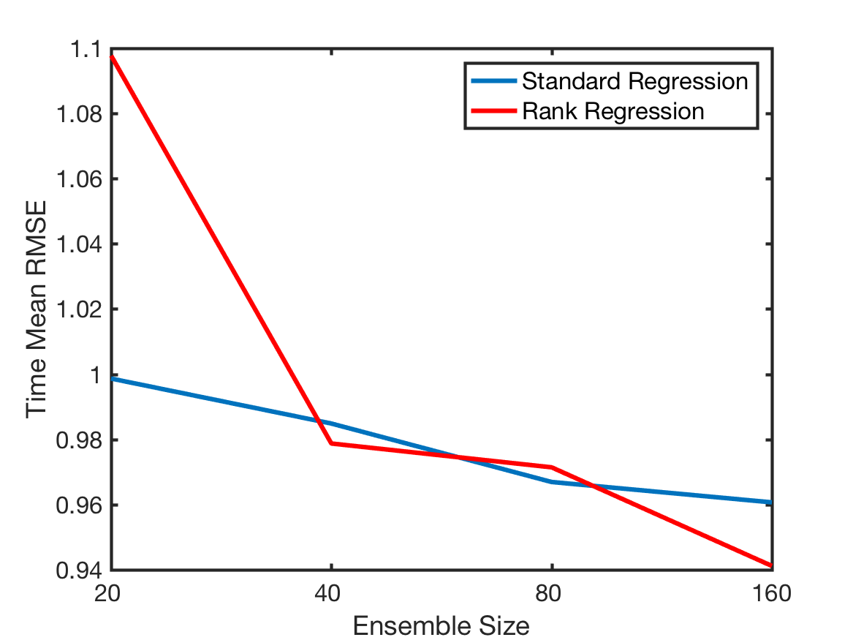
Results: Standard and Rank Regression
Error variance 16, every hour

Slide 50
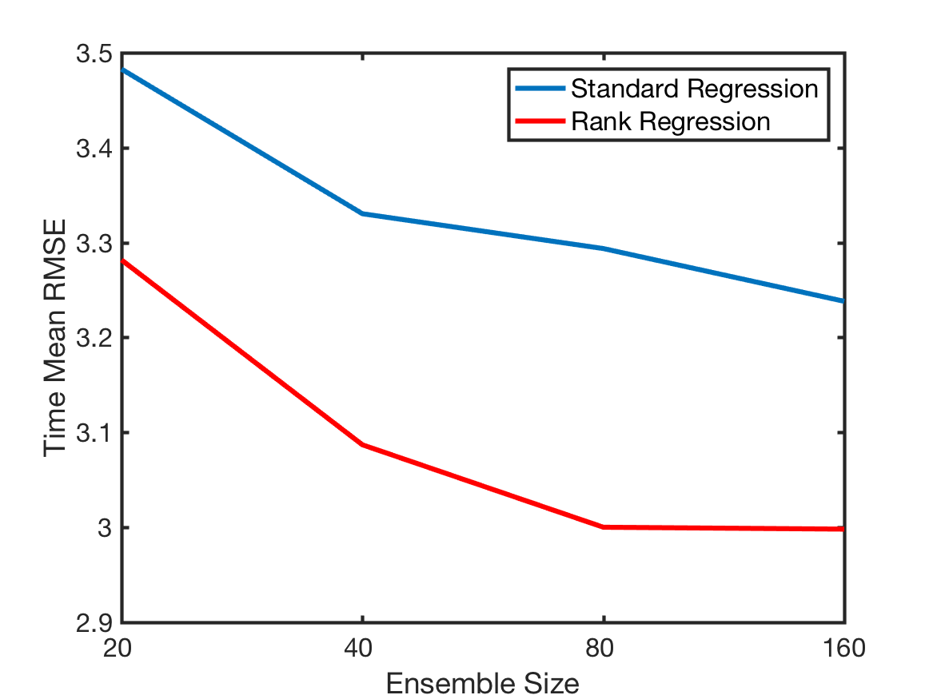
Results: Standard and Rank Regression
Error variance 16, every hour
Log, error variance 1024, every 12 hours

Slide 51
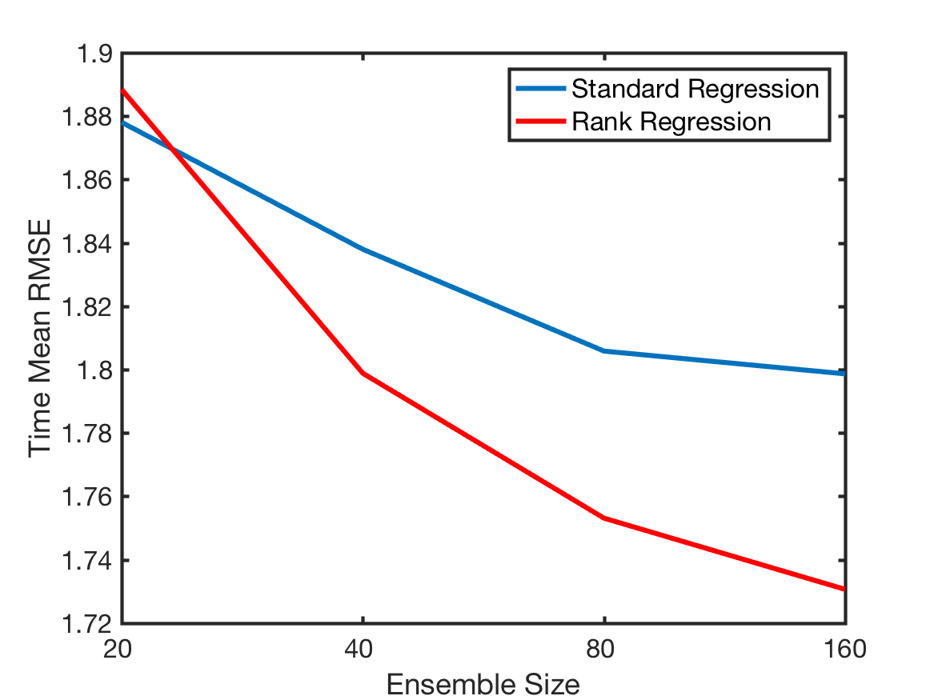
Results: Standard and Rank Regression
Error variance 16, every hour
Log, error variance 1024, every 12 hours
Error variance 1, every 12 hours

Slide 52
Conclusions
Sequential ensemble filters can:
Apply non-Gaussian methods in observation space,
Nonlinear methods for bivariate regression.
Lots of things to explore in this context.
Notes:
Slide 7: GPS occultation forward operators
Non-local refractivity : (Sokolovskiy et al., MWR 133, 2200-2212)
NEED DETAILS OF ALGORITHM step size???
upper limits
grid pictures for different latitudes
Three pictures exist: ~jla/talks_and_meetings/2009/ams/cam_gps_talk/gps_lat*
Expect minor differences with coarse grid, larger near poles

Slide 53
Conclusions
Local regression with incremental update can be effective for locally smooth, continuous relations.
Can be expensive for ’noisy’ bivariate priors:
Requires large subsets (hence large ensembles),
Subsets can be found efficiently,
Incremental update is a multiplicative cost.
Can provide lower bounds for accuracy in some cases.
Notes:
Slide 7: GPS occultation forward operators
Non-local refractivity : (Sokolovskiy et al., MWR 133, 2200-2212)
NEED DETAILS OF ALGORITHM step size???
upper limits
grid pictures for different latitudes
Three pictures exist: ~jla/talks_and_meetings/2009/ams/cam_gps_talk/gps_lat*
Expect minor differences with coarse grid, larger near poles

Slide 54
Conclusions
Rank regression effective for monotonic bivariate relations.
May be effective for:
Nonlinear forward operators,
Transformed state variables (log, anamorphosis, …).
Surprisingly effective for some more standard cases.
Moderate increase in cost.
Should be studied further.
Notes:
Slide 7: GPS occultation forward operators
Non-local refractivity : (Sokolovskiy et al., MWR 133, 2200-2212)
NEED DETAILS OF ALGORITHM step size???
upper limits
grid pictures for different latitudes
Three pictures exist: ~jla/talks_and_meetings/2009/ams/cam_gps_talk/gps_lat*
Expect minor differences with coarse grid, larger near poles

Slide 55
All results here with DARTLAB tools freely available in DART.
www.image.ucar.edu/DAReS/DART
Anderson, J., Hoar, T., Raeder, K., Liu, H., Collins, N., Torn, R., Arellano, A., 2009: The Data Assimilation Research Testbed: A community facility.
BAMS, 90, 1283—1296, doi: 10.1175/2009BAMS2618.1

